Slide 1
Predicting Fire Severity by using Fire Radiative Power and Brightness as proxies

Slide 2
Background
Approx 65k wildfires in the US in 2024 (+14% YoY)
8.9 million acres burned (+300% YoY)
California saw the highest number of individual fires, ~9k
Over 4500 structures destroyed, and 11 dead
Estimated losses at between $250B - $275B
LA fires estimated at $135B - $150B
Can we predict FRP and Brightness to measure the severity of a fire, and therefore allocate resources effectively?
Brightness is a measure of the amount of radiation received by the sensor, expressed in Kelvin
FRP is measure of the energy released by a fire per unit time, measured in MW

Slide 3
Data Sources
NASA FIRMS - Fire Information for Resource Management System
Historical data of global fire events
Copernicus ERA5 Reanalysis data
Hourly weather data: wind speed and direction, temperature
NASA SRTM - Shuttle Radar Topography Mission
Terrain elevation, slope, aspect
Data from 10 March 2024 to 9 March 2025

Slide 4
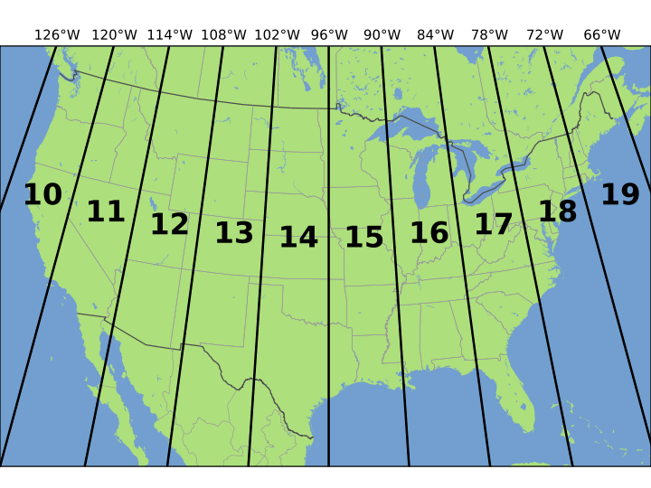
Data Processing
NASA FIRMS data (fire)
Define bounds, general data cleaning
Copernicus ERA5 Reanalysis data (weather) - relatively low res
In GRIB format, data extraction from GRIB to CSV
Combined 1 and 2 by using IWD to match coordinates. Spatial extrapolation required
NASA SRTM data (terrain) - very high res
In .tif format. Used Rasterio module and QGIS to open/view/understand/process data
Split the terrain file into 25 smaller, more manageable chunks
Reprojected coordinates on UTM zones
Extracted terrain info for each file into a csv (total size >200GB, hence batch processing)
Looped through each terrain file and used IWD to match terrain data with fire/weather data

Slide 5
Choosing location
Focused analysis on West Coast US
High wildfire activity and intensity in recent years
Lots of data available from agencies such as USGS, NOAA, NASA etc
Mix of different terrains, mountains, forests, grassland, varied climate zones
Coordinates bounds
Latitude 32 to 49 (southern california to northern washington)
Longitude -125W to -113W (pacific coastline to east edge of california)
Data focused particularly on California, Oregon, Nevada, Washington

Slide 6
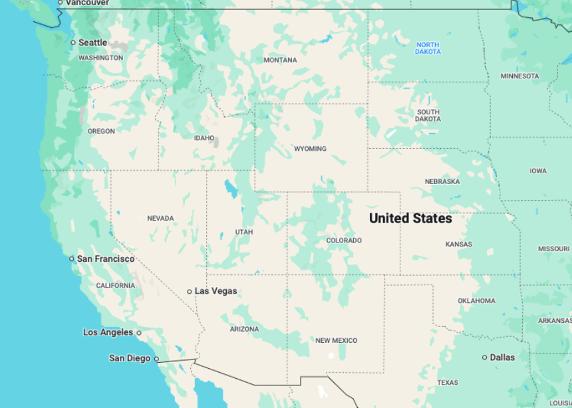

Slide 7
Model Development
Multi target Regression
Fire Radiative Power
Brightness
ML Approach
Linear regression
Polynomial regression, degree = 2
Decision Tree
Random Forest
Light Gradient boost machine
XG Boost
ANN
Find the best one or two
Hyperparameter tuning using GridSearchCV
Use R2 and RMSE as evaluation metrics

Slide 8
Model Performance
Model | n_estimators | max_depth | learning_rate | RMSE_FRP | RMSE_Brightness | R2_FRP | R2_Brightness | Time (seconds)
Linear | - | - | - | 7838 | 215 | 0.155 | 0.576 | -
Polynomial | - | 2 | - | 7209 | 197 | 0.223 | 0.611 | -
Decision Tree | - | - | - | 9672 | 258 | -0.04 | 0.492 | -
RF | 100 | - | - | 5224 | 138 | 0.437 | 0.727 | -
RF (Tuned) | 100 | 50 |  | 5466 | 156 | 0.411 | 0.691 | 531
LightGBM |  |  | 0.05 | 5761 | 184 | 0.379 | 0.637
LightGBM (Tuned)
XGBoost | 100 |  |  | 5746 | 169 | 0.381 | 0.664
XGBoost (Tuned 1) | 1500 | 12 | 0.05 | 4931 | 145.65 | 0.469 | 0.713 | 877
XGBoost (Tuned 2) | 2500 | 12 | 0.05 | 5095 | 148.36 | 0.451 | 0.708 | 1312
XGBoost (Tuned 3) | 2500 | 12 | 0.01 | 4792 | 148.06 | 0.484 | 0.709 | 2805
XGBoost (Tuned 4)* | 3000 | 15 | 0.005 | 4856 | 144 | 0.477 | 0.715 | 2914
Polynomial outperformed Linear - capturing non linear relationships is key
Tree based models perform better with Random Forest being the strongest, and Light GBM and XG Boost performing very similarly
Prioritised Random Forest and XG Boost parameter tuning
On further tuning, RF did not improve, whereas XGB improved, but soon started to become very expensive, and started getting diminishing returns
Decided to try Neural Network

Slide 9
Neural Network Performance
Model | # layers | # per layer | Initialiser | Activation functions | Optimiser | Learning rate | Batch size | Epochs | Dropout rate | RMSE_FRP | RMSE_Brightness | R2_FRP | R2_Brightness
ANN1 | 3 | 256, 128, 64 | He_normal | ReLU | Adam | 0.001 | 64 | 20 | - | 6397 | 218 | 0.31 | 0.569
ANN2 | 2 | 128, 64 | He_normal | ReLU | Adam | 0.001 | 32 | 50 | - | 6160 | 204 | 0.336 | 0.598
ANN3 | 4 | 512, 256, 128, 64 | He_normal | ReLU | Adam | 0.001 | 32 | 50 | - | 6114 | 201 | 0.341 | 0.604
ANN4 | 3 | 256, 128, 64 | Lecun_normal | elu | Adam | 0.001 | 32 | 50 | - | 6134 | 196 | 0.339 | 0.614
ANN5 | 3 | 256, 128, 64 | Lecun_normal | tanh | RMSprop | 0.0001 | 64 | 20 | 0.2 | 8709 | 1052 | 0.06 | -185
ANN6 | 4 | 512, 256, 128, 64 | he_normal | ReLU | Adam | 0.001 | 32 | 50 | 0.1 | 6247 | 223 | 0.327 | 0.561
Neural Network performed relatively bad across the board
XGBoost performs better than ANN - ANN might not be the best model for my data

Slide 10
Model Selection
Chose XGBoost v1 as my final model, although not perfect
Diminishing returns
More tuning led to smaller and smaller improvements
Data limitations
The data could have inherent limitations that prevent from achieving perfect predictions
Model capacity
XBoost is very powerful, and if performance is not found with further tuning, the model may have captured most of the relationships in my data

Slide 11
Next Steps
Deploy my app on Streamlit and package in a Docker container
Use additional variables such as precipitation and solar radiation (weather)
Use additional terrain variables, such as terrain type
Extend my analysis to a bigger size, or more historical data

Slide 12
Challenges and Limitations
Computational challenges - even Colab Pro was sometimes unable to handle the amount of data being processed
Had to limit my project to US West Coast
Extracting data from .grib (weather) and .tif (terrain) into a usable format, such as CSV
The terrain data extracted as a CSV was over 200GB, so had to rely on batch processing to:
Extracting the data
Match the data to the fire events
Learning new modules on a short time scale
Rasterio for extracting terrain data
SciPy to perform spatial interpolation to match the weather and terrain data to the fire events
GitHub file upload limitations

Slide 13
Contact details
Dawood Butt
dawoodahmedbutt@gmail.com
LinkedIn
GitHub

